Slide 1

Dharmeshkumar Madhukarbhai Padvi B00867068 Supervisor: Muskan Singh Second Marker: Jim Harkin 15/09/2023
Multilingual Named Entity Recognition using MultiCoNER-II
School of Computing, Engineering & Intelligent Systems

Slide 2
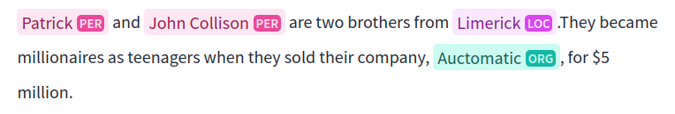
Introduction
Named entity recognition(NER) is a sub-task in the field of NLP(Natural Language Processing). To be more specific NER is the text classification task in which a piece of the text is classified as their corresponding categories(person names, organisation names, etc).Basically, it involves two core tasks: tokenizing and labelling a piece of the information written in the human-readable languages. This field poses some challenges when it comes to recognizing the entities in different domains, for example, medical or creative names with more than one language.
Simple example of the monolingual Named entity recognition:

Slide 3
Challenges In The Field Of NER
Complex named entities such as(Creative names , Medical terminologies, etc. )
Multiple Domains(Medical, Creative works, Organization names)
Multiple Languages(English, Spanish, Hindi, Bangla, Chinese, Swedish, Farsi, French, Italian, Portuguese, Ukrainian, German)

Slide 4



The Aim of the project
The aim of the project is to represent the development of a robust and high score achieving score ensemble multilingual NER system using pre-trained models such as RemBERT, mBERT, and xlm-r for 12 languages, and the weighted mean ensemble method to combine the predictions from these models 36 with multiple domains ; also, with the limited hardware support. To train these models, the MultiCoNER-2(12-monolingual subsets)dataset was used with the help of Hugging-face's transformers library and Pytorch library for deep learning.

Slide 5
Database
MultiCoNER-II database consist of total 12 languages, such as English, Spanish, Hindi, Bangla, Chinese, Swedish, Farsi, French, Italian, Portuguese, Ukrainian, German, for fine-grained for Complex named entity recognition, also, its fine-grained taxonomy contains 36 classes, which represents the existing real world challenges for NER systems. The dataset is MultiCoNER-II is a second version(v2) of the dataset MultiCoNER released publicly as a part of as part of the SemEval 2022 Task#11[12]. Furthermore, It represents 3 domains such as wiki sentences(LOWNER) search queries(ORCAS-NER), questions(MSQ-NER), and. MultiCoNER taxonomy represents 6 ner-tagsets representing categories such as person, group, location, corporation, creative work. Table I. represents the detailed taxonomy with 6 ner-tagsets.

Slide 6
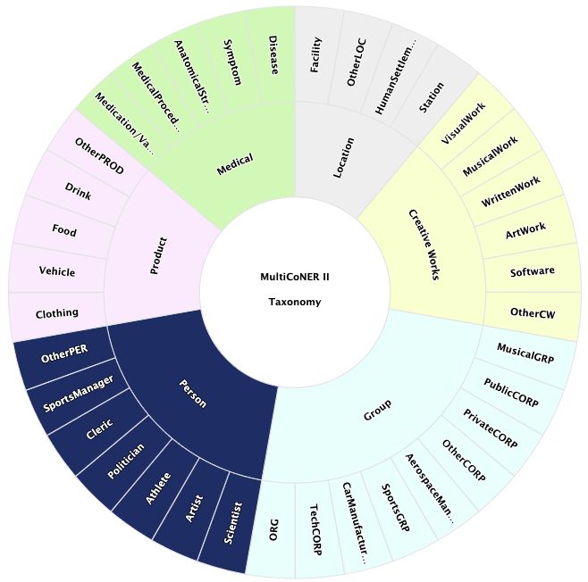
Database Taxonomy

Slide 7
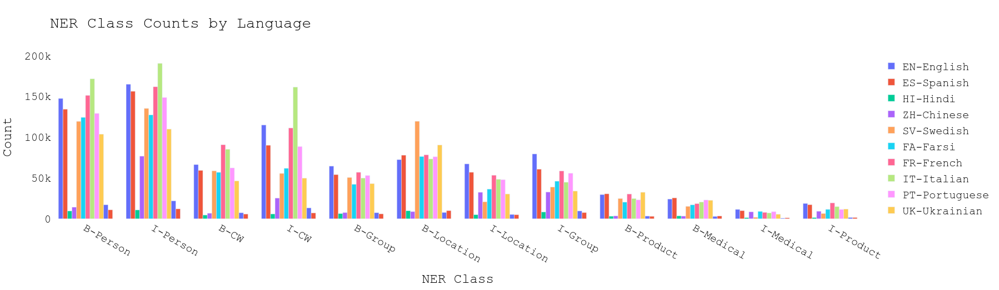
Data Distribution

Slide 8
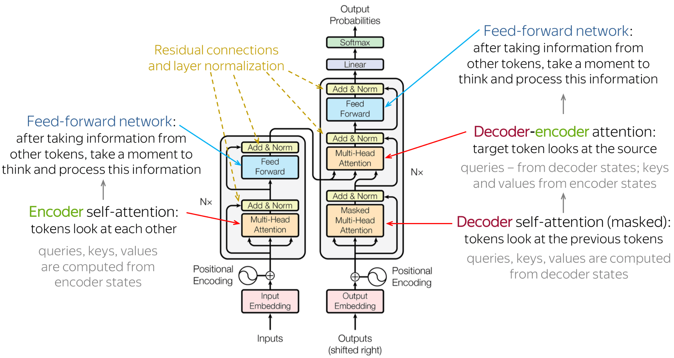
Transformer architecture

Slide 9
Model Selection
RemBERT (Rebalanced mBERT)
mBERT (Multilingual BERT where BERT stands for ‘Bidirectional Encoder Representations from Transformers’)
XLM-R ( xlm-roBERTa is a multilingual lingual version of the model RobBERTa where RoBERTa means optimised BERT pre-training approach )
High benchmarking achieving transformer based models like RemBERT, mBERT, xml-r had been used in the competition named SemEval task-2 MultiCoNER-II, and showcased the best predicting abilities of these transformers based multilingual models’

Slide 10
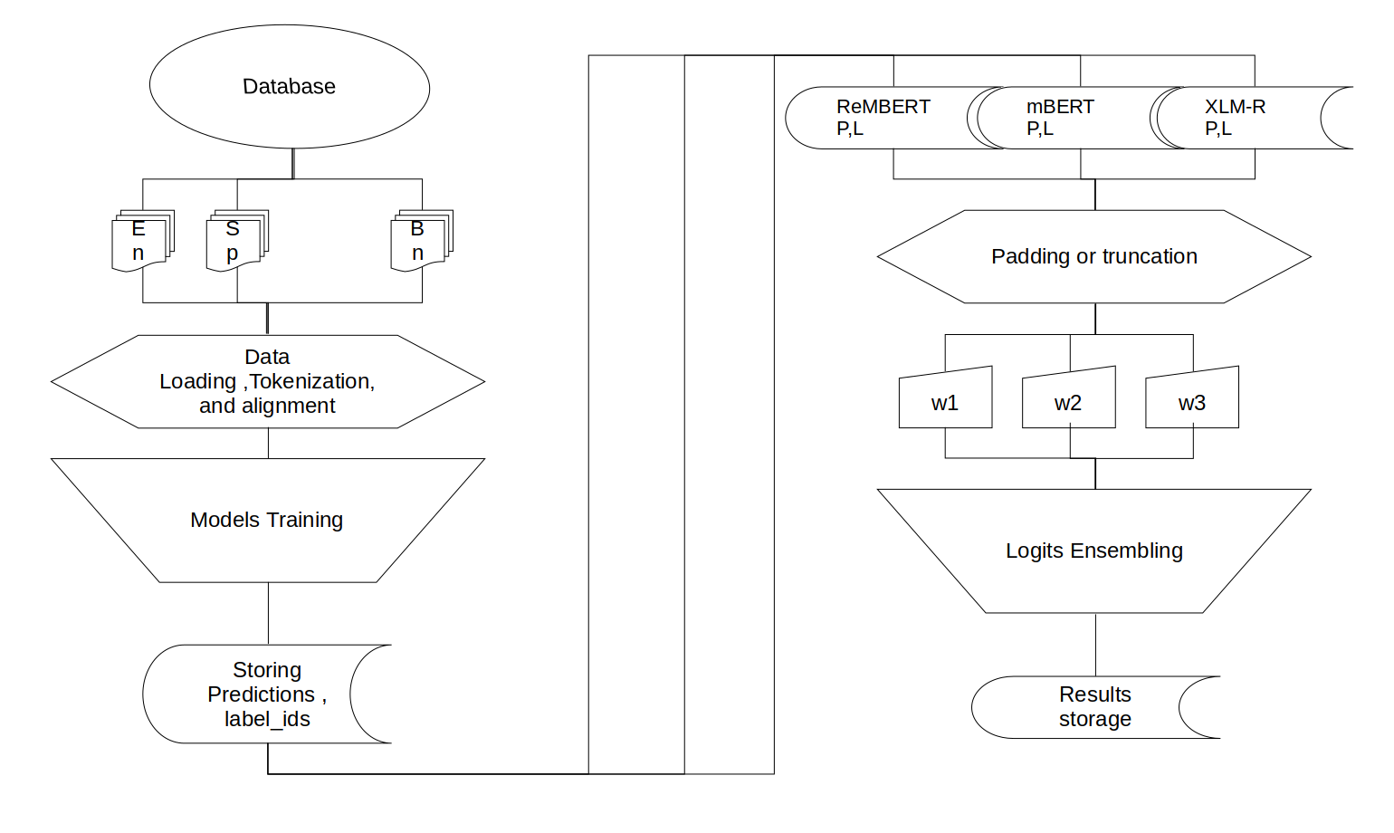
Project Implementation Process Diagram

Slide 11
Data Modeling & Fine-Tuning Parameters
We trained 36 models with learning-rate 2.5e-5 for all languages, use 2 epochs for all the languages, and models, excluding the RemBERT models for low-resource languages(Hindi, Chinese, German, and Bangla). To leverage maximum transfer learning from the pre-trained model, we trained low-resource languages for 3 epochs. Due to limitations of the hardware resources maximum token size of the Chinese and Bangla RemBERT models, we trained the model with 8 batch sizes. For the rest of the RemBERT models, including mBERT, xlm-r, we use 16 batch-size. Batch size is also a hyperparameter which is associated with better model generalisation, and faster convergence. With 0.01 weight decay, 100 warm up steps, and liner learning-rate_scheduler, all 36 models were trained.

Slide 12
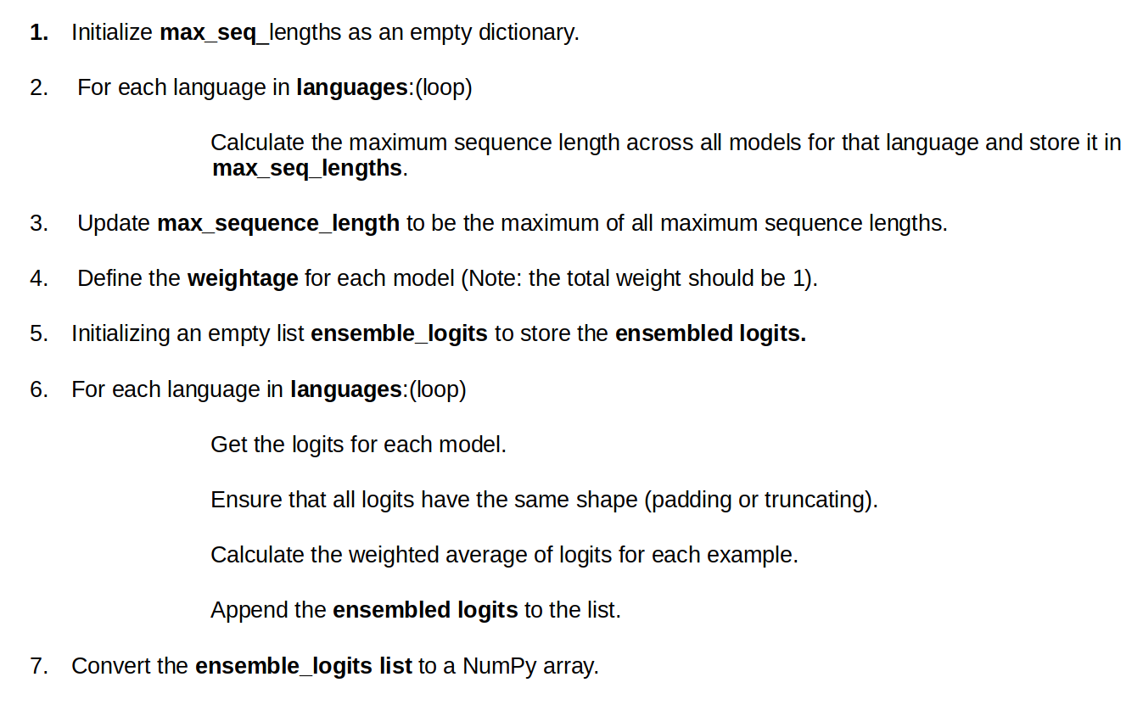
Algorithm for Ensemble Modeling

Slide 13
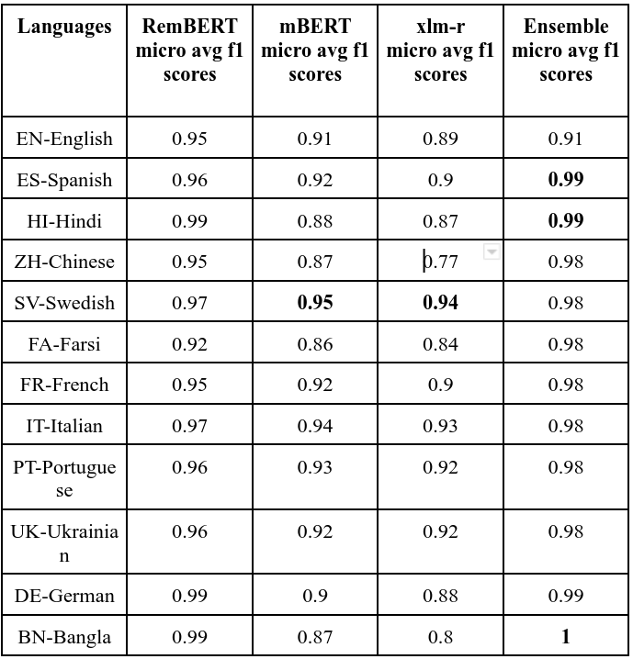
Results

Slide 14
Brief Code Will Be Demonstrated On Google Colab

Slide 15
Thanks!

